Slide 1
Paving the way for a Greener Digital Future
CHHAVI VERMA

Slide 2


Unveiling Google’s Cooling Secrets & Paving the way for a Greener Digital Future

Slide 3
THE COMPANY
The internet thrives on constant energy, but Google recognizes the need for a greener digital future. Its ambitious goal of achieving 24/7 carbon-free energy by 2030. While data center cooling innovations play a role, the focus expands beyond these "secrets." Procurement: Matching hourly electricity needs with renewable sources like wind and solar. Innovation: Actively developing and supporting advancements in clean energy technology. Advocacy: Partnering with organizations and governments to accelerate grid decarbonization.

Slide 4
INTRODUCTION
Here’s what they’ve achieved:
Hundred percent Renewable Energy: Google achieved this milestone in 2017 by matching its energy consumption with renewable energy sources.
Global Leadership: Google is the world’s largest corporate buyer of renewable energy, with long-term contracts totaling 2.6 gigawatts.

Slide 5
COMPANY GOAL
Here’s what they’ve achieved:
Their Next Challenge:
24x7 Carbon-Free Energy Goal: By 2030, Google aims to operate on carbon-free energy every hour of every day across all grids
Complex Challenge: Achieving 24/7 carbon-free energy is unprecedented but crucial for com- bating climate change.

Slide 6
COMPANY GOAL
Their Next Challenge:
Smarter Clean Energy Deals: Google is developing faster approaches to close clean energy deals for a sustainable future.
Their audacious goal of achieving 24/7 carbon-free energy by 2030 signifies our unwavering dedication to combating climate change.
To tackle this unprecedented challenge, we’re pioneering smarter clean energy deals, driving progress towards a sustainable future.

Slide 7
01
02
INTRODUCTION
PRESENTATION
03
04
ANALYSIS
CONCLUSION

Slide 8
01
What’s inside

Slide 9
THE COMPANIES CONTRIBUTION
Operating sustainably
Their ambition
Their operations
Net-zero carbon
Water stewardship
Circular economy
Nature and biodiversity
Spotlight: Building a more sustainable
campus in Mountain View
Empowering individuals
Their ambition
Their approach
Helping people make
more sustainable choices
Reducing home energy use
Providing sustainable
transportation options
Sharing other actionable information
The journey ahead

Slide 10
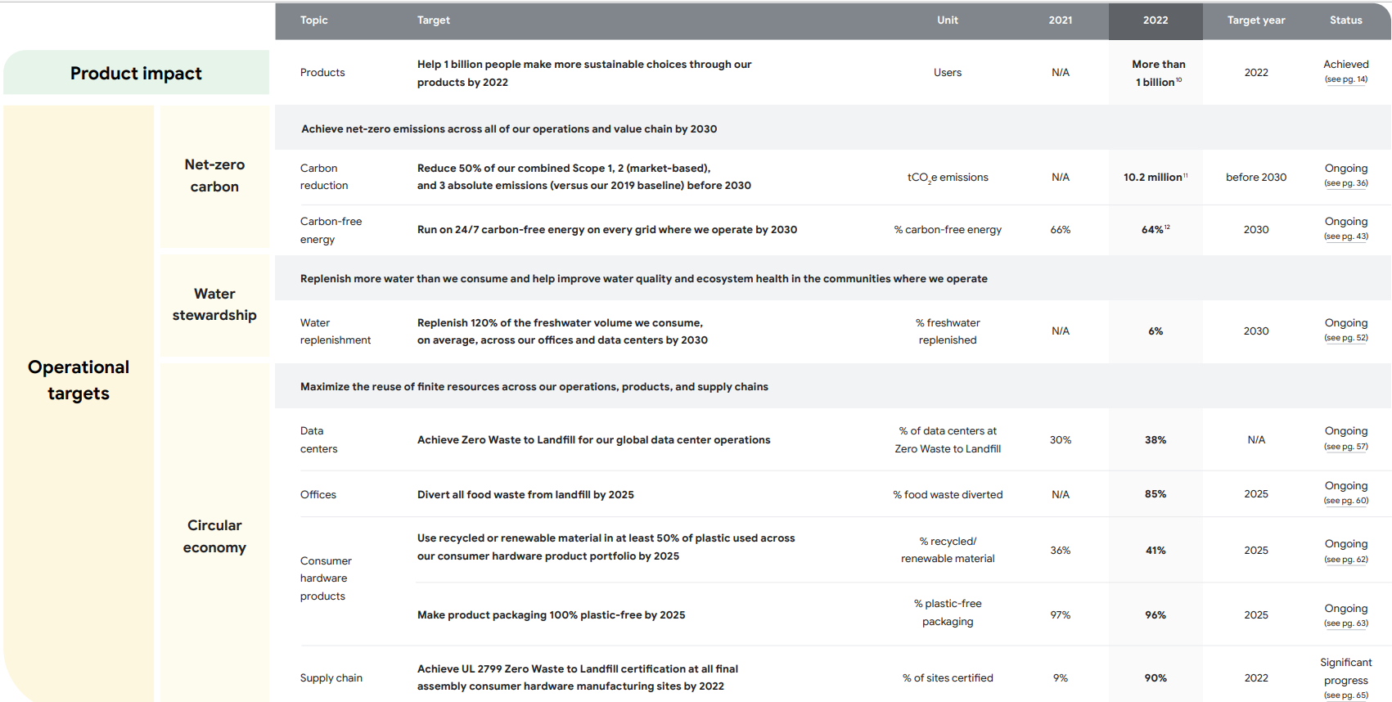
THEIR TARGET SUMMARY

Slide 11
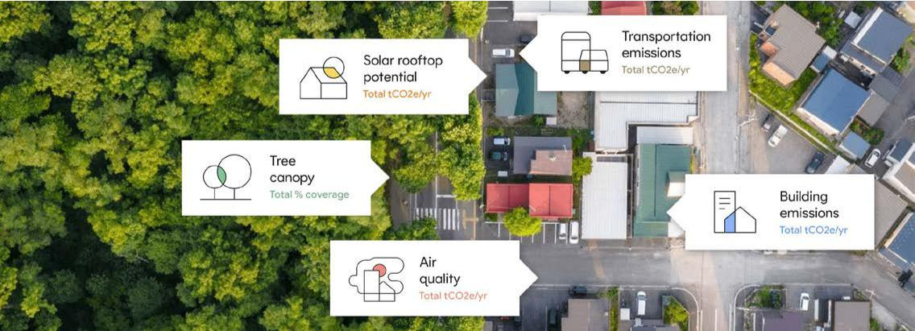
THEIR TARGET SUMMARY
How they are planning to do it & how we’ve executed our code

Slide 12

THEIR TARGET SUMMARY
Empowering individuals
They’re’re empowering people with information to make more sustainable choices
Helping people make more
sustainable choices
Reducing home energy use
Providing sustainable
transportation options
Sharing other actionable
information

Slide 13
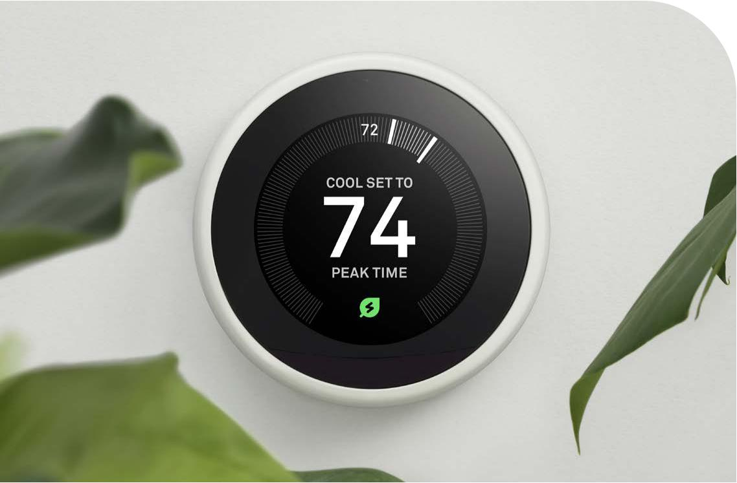
Helping people make more sustainable choices
TARGET 2022 PROGRESS
Help 1 billion people make Achieved: Helped more than
more sustainable choices 1 billion users make more
In 2020, theyannounced a goal to help 1 billion people make more sustainable choices through our products by 2022. The’repleased to share that we reached that goal in 2022, through innovative solutions offered to users, including:
•Google Nest: Programmable energy efficiency schedules for homes that can help users save energy, money, and carbon emissions throughout the day.
•Google Maps: Eco-friendly routing feature that shows users the most fuel-efficient route, based on factors such as traffic and road incline.
•Google Travel: Users can see associated carbon emissions for nearly every flight, sustainability certifications and attributes for hotels, and quickly find more sustainable options.

Slide 14
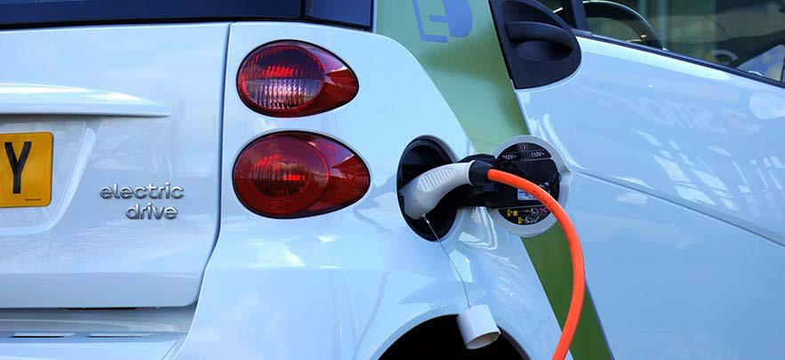
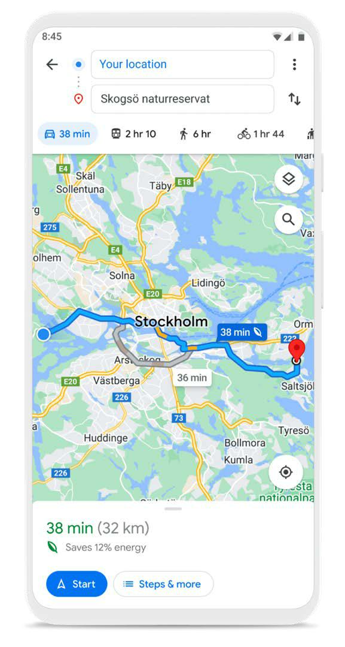
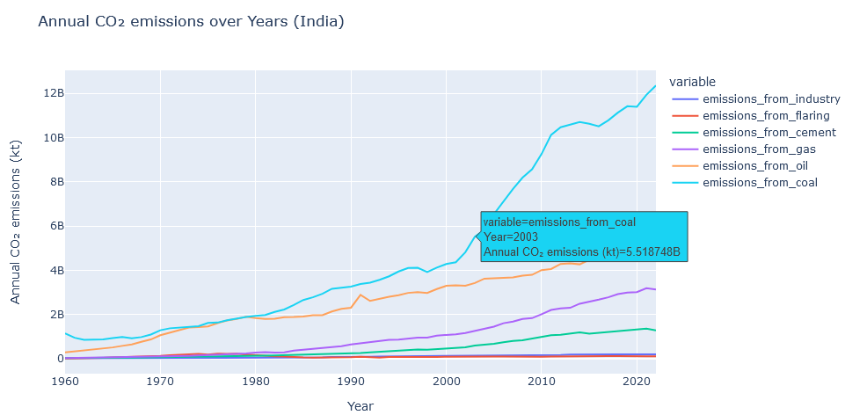
Providing sustainable transportation options
Eco-friendly routing:
Transportation relies more heavily on fossil fuels than any other sector. 38 This is why, for people in most high-income countries, changing travel patterns is a high-impact way to reduce their footprint.
EV’s :
EVs accounted for nearly 14% of new global car sales in 2022, 41 and global search interest for “electric vehicles” reached an all-time high in 2022.
EV’s :
For people considering purchasing a new vehicle, we want to make it easy to understand when switching to a hybrid or electric vehicle makes sense for them. Search can help people figure out how much they can save by going electric by providing fuel savings estimates and information about how similar cars compare in range and emissions.

Slide 15
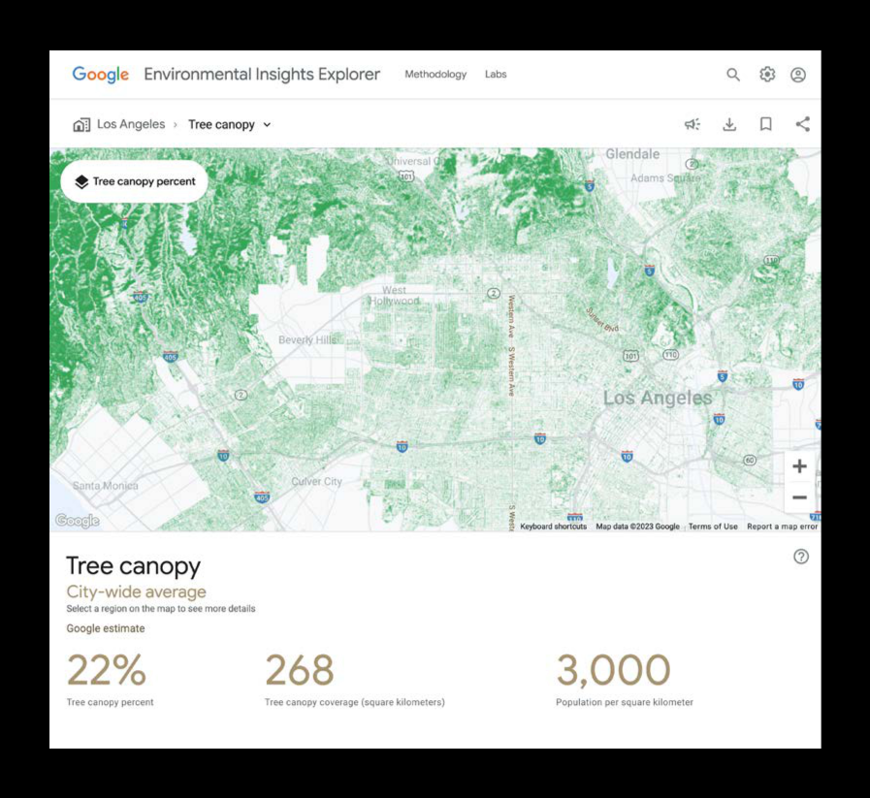
Air quality Google has worked with several cities to capture hyperlocal air quality insights used to help improve the lives and health of residents. They map air quality street-by-street using an electric Street View car, to increase awareness of air quality levels and help implement smart transportation policies. Cool roofs Cool roofs are designed to reflect sunlight and absorb less heat, and they’re especially impactful in communities that may not have access to reliable air conditioning. We’re exploring how our technology—such as AI algorithms and aerial imagery—can help more places implement cool roofs. We’re able to map out the solar reflectivity of cities Road traffic They also know that many cities suffer from urban road traffic, which wastes fuel and creates harmful air pollution. That’s why they created Green Light, an AI tool that measures driving trends at intersections and develops recommendations that city traffic engineers can use to optimize the timing of light changes to reduce stop-and-go traffic. Our recent tests in Hamburg, Germany showed that at traffic lights with our AI-driven recommendations, cars made over 25% fewer stops, resulting in approximately 10% fewer emissions at intersections. 55
Their Approach
Water security
We’re putting Google’s products and technology in service of helping others to study and respond to water security challenges. Improving water security requires an accurate accounting of freshwater resources and how they change over time.
Tree canopy coverage
EIE also provides Tree Canopy Insights, which uses AI and aerial imagery to detect and map tree canopy

Slide 16
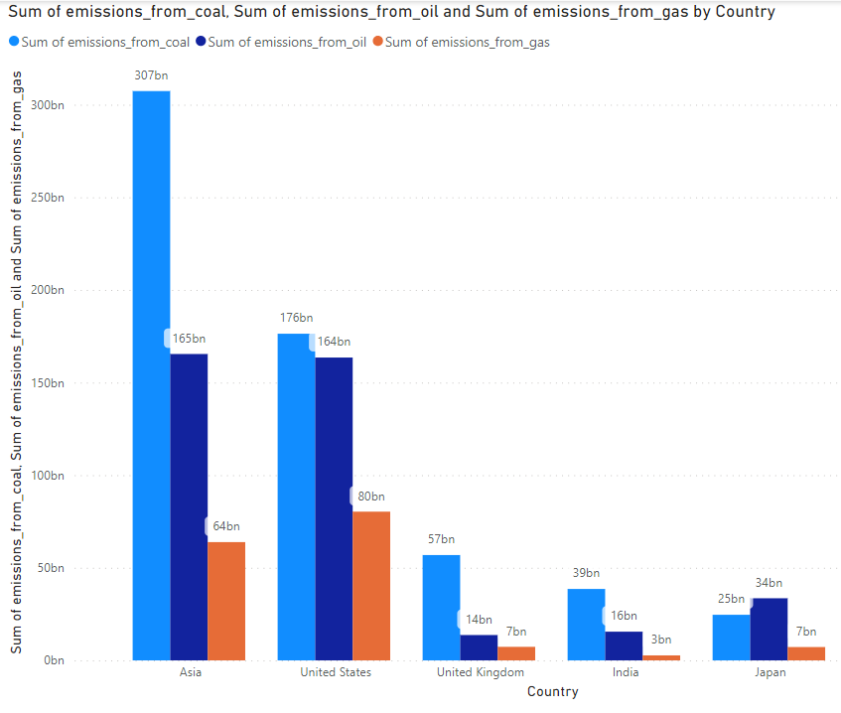
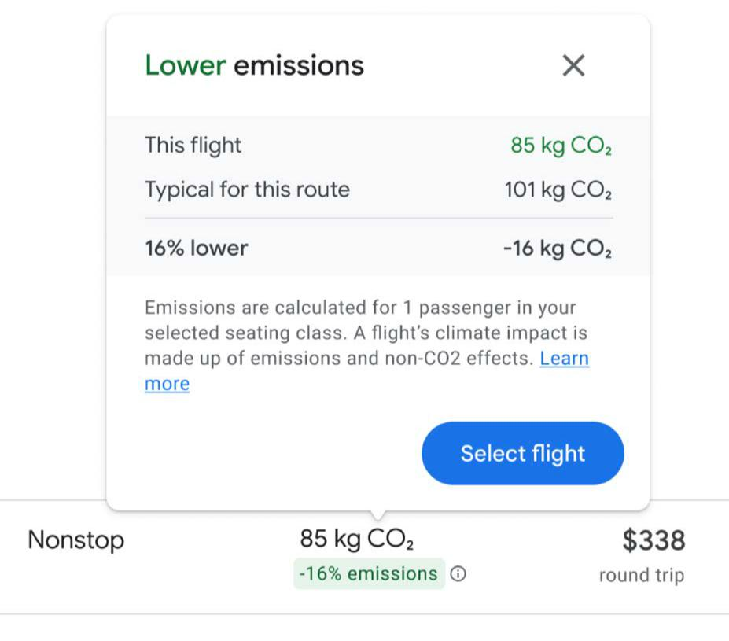
Sustainable commuting
Their sustainable way to travel is to avoid driving altogether, which is why we’re making it easier to use Google Maps for sustainable commuting in urban areas, by providing mass transit options, bike routes, bike shares, and walking directions.
By tapping on the Google Maps transit icon, individuals can get directions to their destination by bus, train, subway, and even ferry. Google Maps provides, on average, more than 2 billion kilometers (1.2 billion miles) of public transit results per day.
Global searches for “e-bikes” have doubled over the past three years. 43 In 2022, we added over 90,000 kilometers (56,000 miles) of bike lanes and bikeable roads to Google Maps. Individuals can also find nearby bike and scooter shares in over 400 cities around the world.

Slide 17

Challenges to address
While we’re excited about our net-zero emissions journey, we recognize that we face many challenges. For example:
Growing energy needs
• As we work towards our absolute 50% emissions reduction target, our business is continuing to evolve to meet the needs of a rapidly digitalizing world, and to harness the opportunities presented by AI technology.
Availability of carbon-free energy
•There are often long lead times between our investments and resulting GHG reductions. For example, with new wind and solar projects, it can take years before projects that we contract are constructed and begin to generate clean electricity.
•System-level decarbonization is proceeding more slowly than needed in many regions and sectors, and while we aim to accelerate these changes through our efforts and engagement, they aren’t within our control.
Use of carbon removals
•Because the carbon removals sector is in the earliest stage of development, costs are currently high, and there are limited volumes of removals available for purchase. 68.
Their Approach :
Carbon reduction Reduce emissions across our operations and value chain
Carbon-free energy
Advance carbon-free energy across
our operations and value chain
Carbon removals
Address our residual emissions
with carbon removals

Slide 18
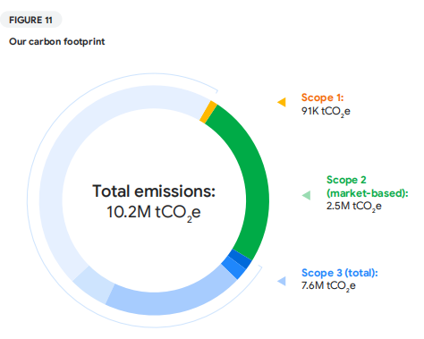
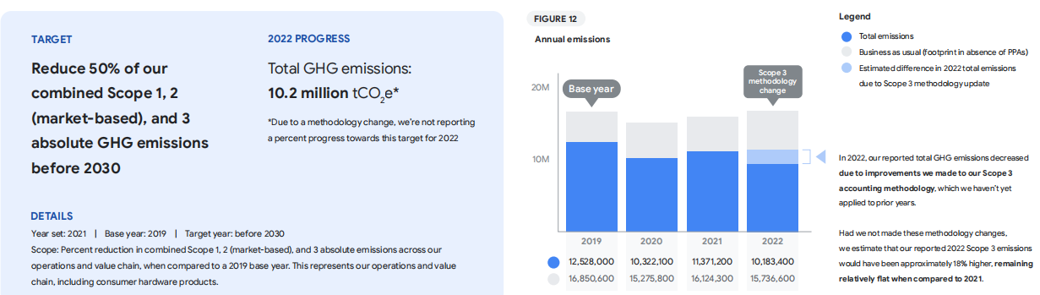
THEIR SOLUTIONS & THEIR CARBON FOOTPRINT
MERCURY
Our emissions reduction
goal
In 2022, our total GHG emissions were approximately
10.2 million tCO2
e. We revised our Scope 3 methodology
to calculate upstream emissions related to consumer
hardware manufacturing by moving away from using a
spend-based methodology to a Life Cycle Assessment
(LCA)-based methodology.
Mercury is the closest planet to the Sun and the smallest one in our Solar System

Slide 19
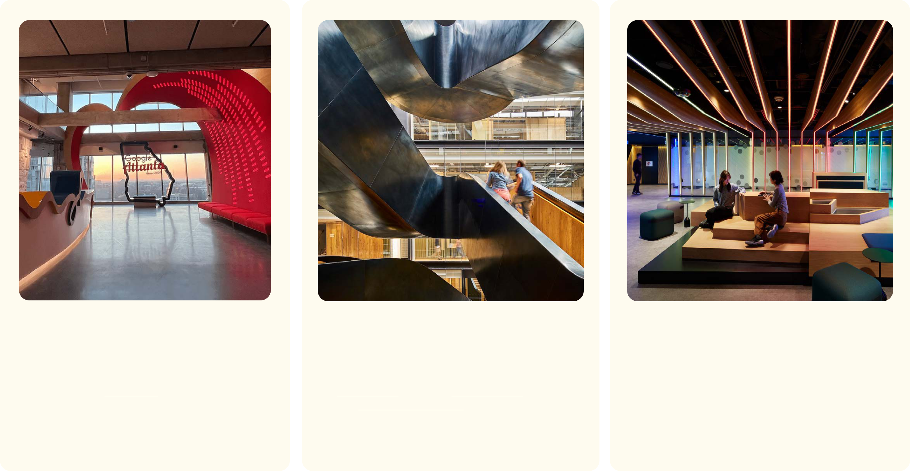
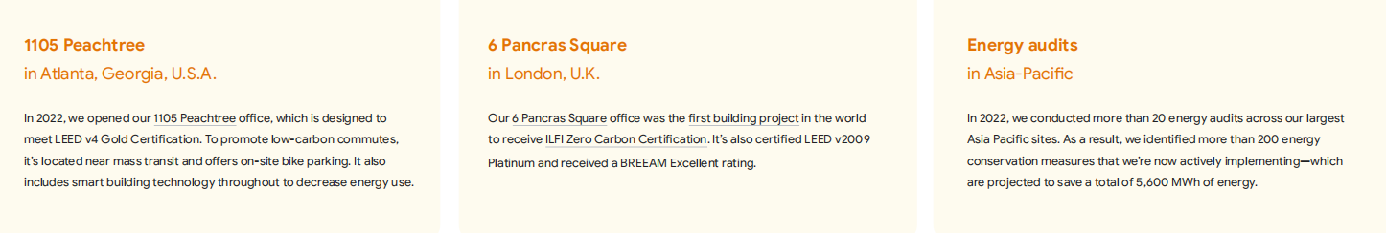
OUR SERVICES
MERCURY
JUPITER
VENUS
EXAMPLE OF EFFICIENT DATA CENTERS
Mercury is the closest planet to the Sun
Jupiter is the biggest planet of them all
Venus is the second planet from the Sun

Slide 20
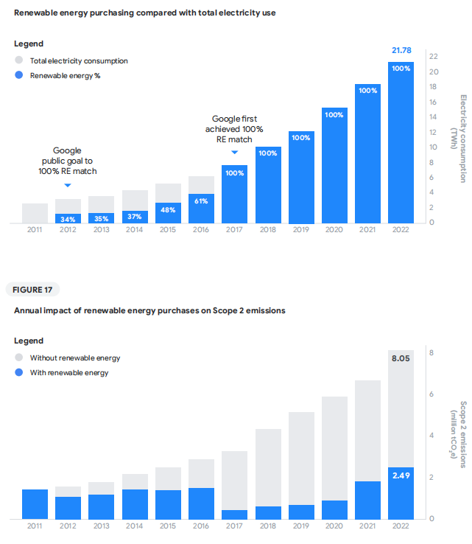
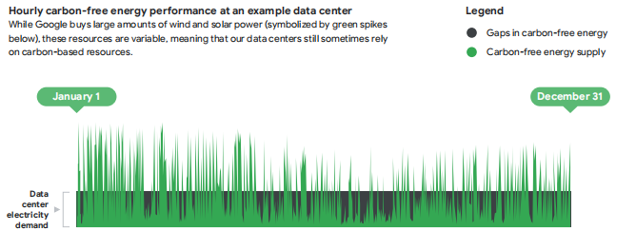
Advancing carbon-free energy
Their primary approach for reducing our Scope 2 emissions
is through the procurement of carbon-free energy. 83Since
2017, we’ve matched 100% of the electricity consumption of
our global operations with purchases of renewable energy
on an annual basis. In 2022, we also saw projects we’d contracted over the past few years becoming operational in Belgium, Chile, Denmark, and Finland—providing important clean energy resources to the grids where we operate, and bringing us closer to 24/7 CFE

Slide 21
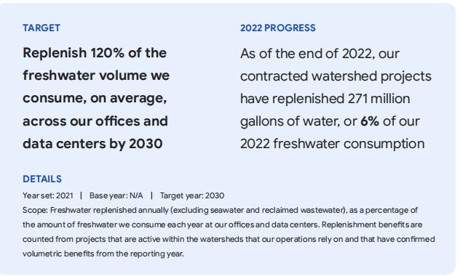
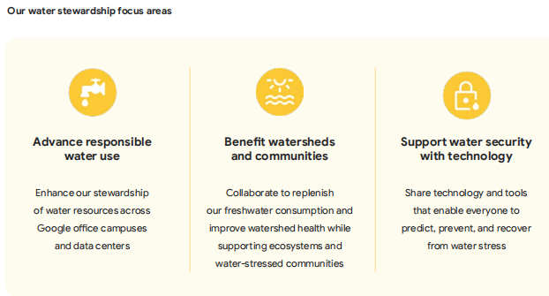
Advancing responsible water use
Committed to advancing and enhancing our water management practices across our operational footprint at Google’s offices and data centers around the world. We continue to collaborate, test, and share our learnings on responsible water use. This includes accelerating water reuse practices across our offices and data centers, and tailoring site-specific solutions based on facility types, locations, and local water contexts. In 2022, total water consumption at our data centers and offices was 5.6 billion gallons—the equivalent of what it takes to irrigate 37 golf courses annually, on average, in the southwestern United States. 98 Wherever feasible, we try to use non-potable sources of freshwater and alternatives to freshwater

Slide 22
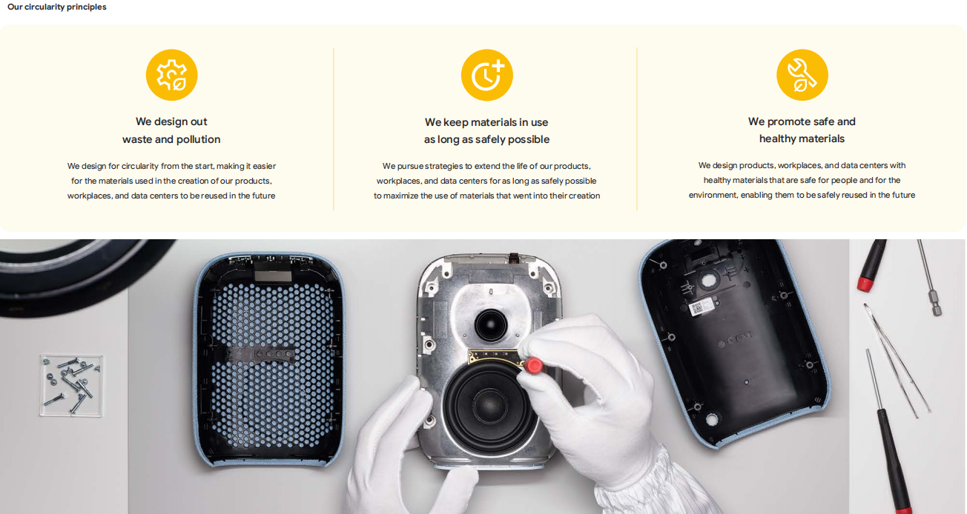
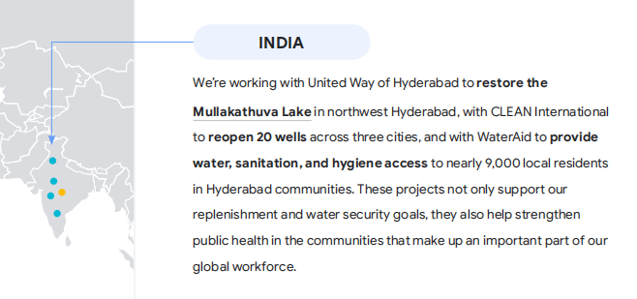
Advancing responsible water use

Slide 23
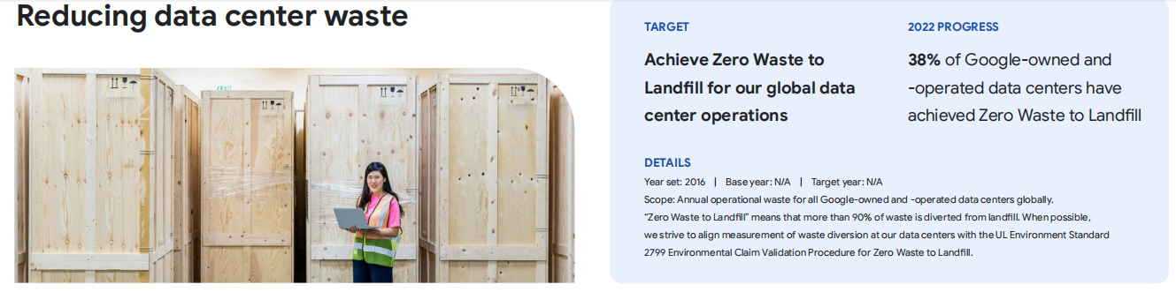
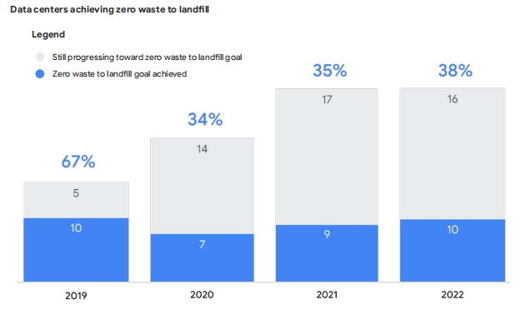
Since 2015, we’ve resold more than 37 million hardware components from our data centers into the secondary market for reuse by other organizations, including nearly 5 million resold components in 2022 alone. As of the end of 2022, 21% of components used for server deployment, maintenance, and upgrades were refurbished inventory. Looking forward, we continue to face challenges for waste diversion at a local level due to the lack of availability of recycling infrastructure

Slide 24
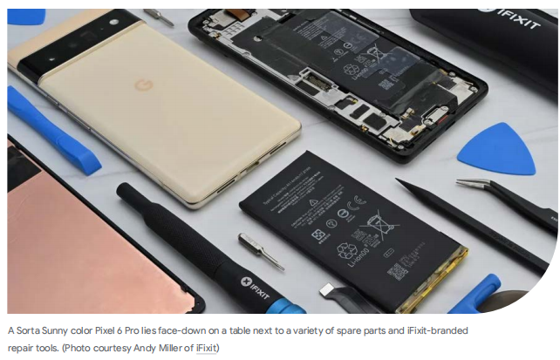
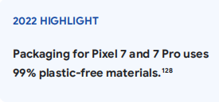
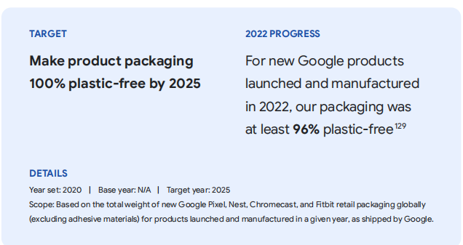
Advancing Sustainable packaging
Product packaging typically contains many materials—like the plastic film materials you often see on electronic packages—which can be difficult to recycle. That’s why we’re committed to eliminating plastic from our hardware product packaging by 2025. By focusing on fiber-based materials, we’re enabling consumers to
more easily recycle our packaging and ensure that the materials will be accepted in as many recycling systems as possible.

Slide 25
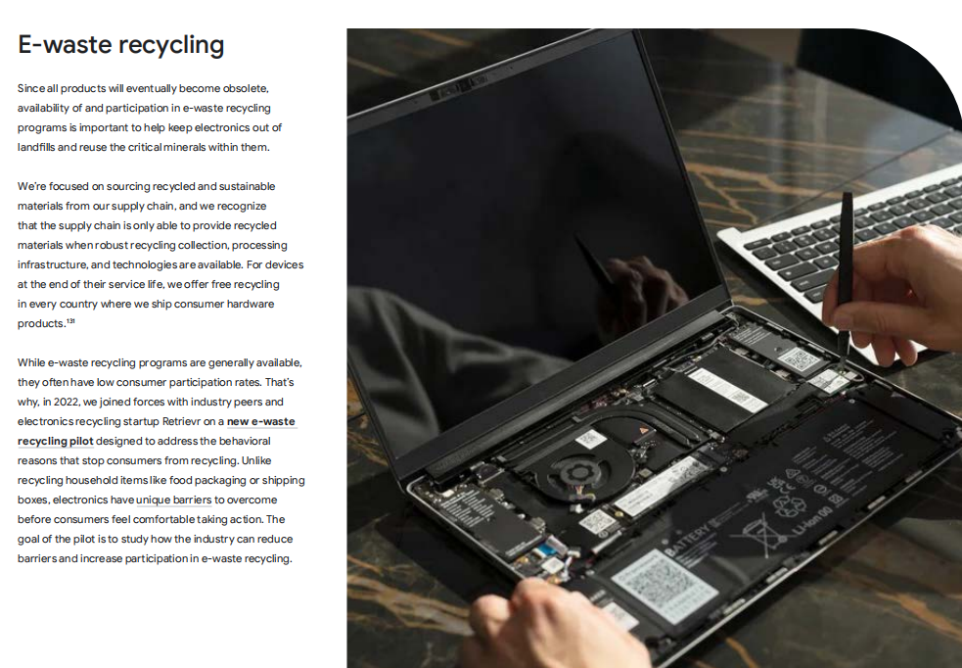
In 2022, we announced ChromeOS Flex and the
Chromebook repair program, which aim to extend
the useful life of laptops, PCs, and Chromebooks alike.
ChromeOS Flex helps extend the life of aging Macs, PCs,
and Linux devices by converting them to the ChromeOS
ecosystem and reducing the amount of e-waste that’s
generated. In addition to providing up to eight years of
software updates for Chromebooks, schools can easily
identify which Chromebooks have commonly repaired
components—like the keyboard, display, and palmrest—
through our new repair program site.

Slide 26
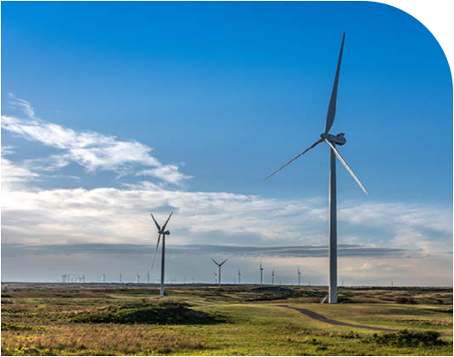
GOOGLE IT INFRASTRUCTURE
Innovation in Computing: Google has been at the forefront of inventing warehouse-scale com- puting and cloud-scale software infrastructure¹. Their engineering teams meticulously design and build both hardware and software components. Notably:
Global Network Systems: Google’s planetary-scale network systems ensure seamless connectiv- ity across its services¹.
Machine Learning Infrastructure: Google leads in ML infrastructure, enabling powerful appli- cations like natural language processing, image recognition, and recommendation systems [7]
Video Accelerators for YouTube: Google optimizes video delivery through dedicated accelera- tors

Slide 27
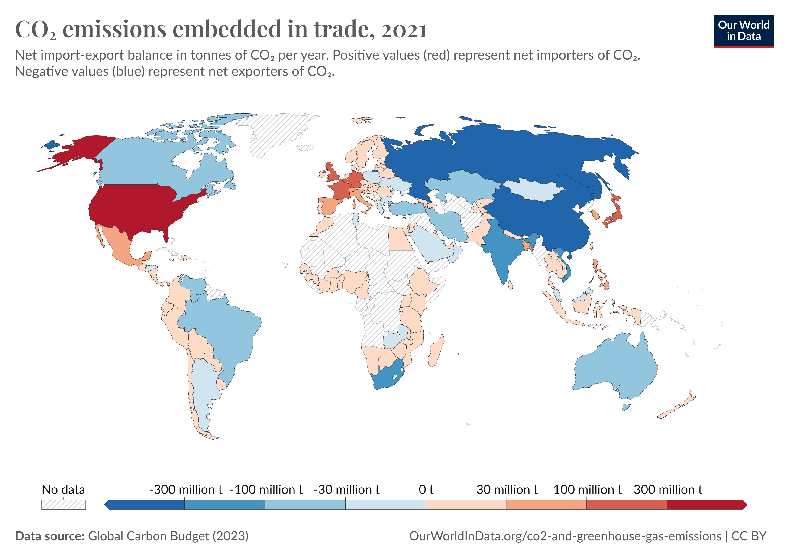
GOOGLE IT INFRASTRUCTURE

Slide 28
GOOGLE CLOUD & VIRTUALIZATION
Google recognizes that cloud computing plays a significant role in addressing IT challenges.
To mitigate environmental impact, Google embraces a green cloud computing strategy.
The goal is to create an energy-efficient cloud environment that:
Maximizes resource utilization without overprovisioning.Leaves fewer carbon footprints. Re- duces greenhouse gas emissions.Minimizes e-waste.
Key techniques include:
Containerization: Efficiently packaging applications for deployment.
Green Data Center Infrastructure Design: Optimizing data center facilities. Server Consolidation: Reducing redundant servers.
Virtual Machine Placement: Efficiently allocating virtual resources. Green Networks and Protocols: Sustainable networking practices. Sustainable Software Development: Environmentally conscious coding. Safe Disposal Techniques (Reuse, Reduce, Recycle).

Slide 29
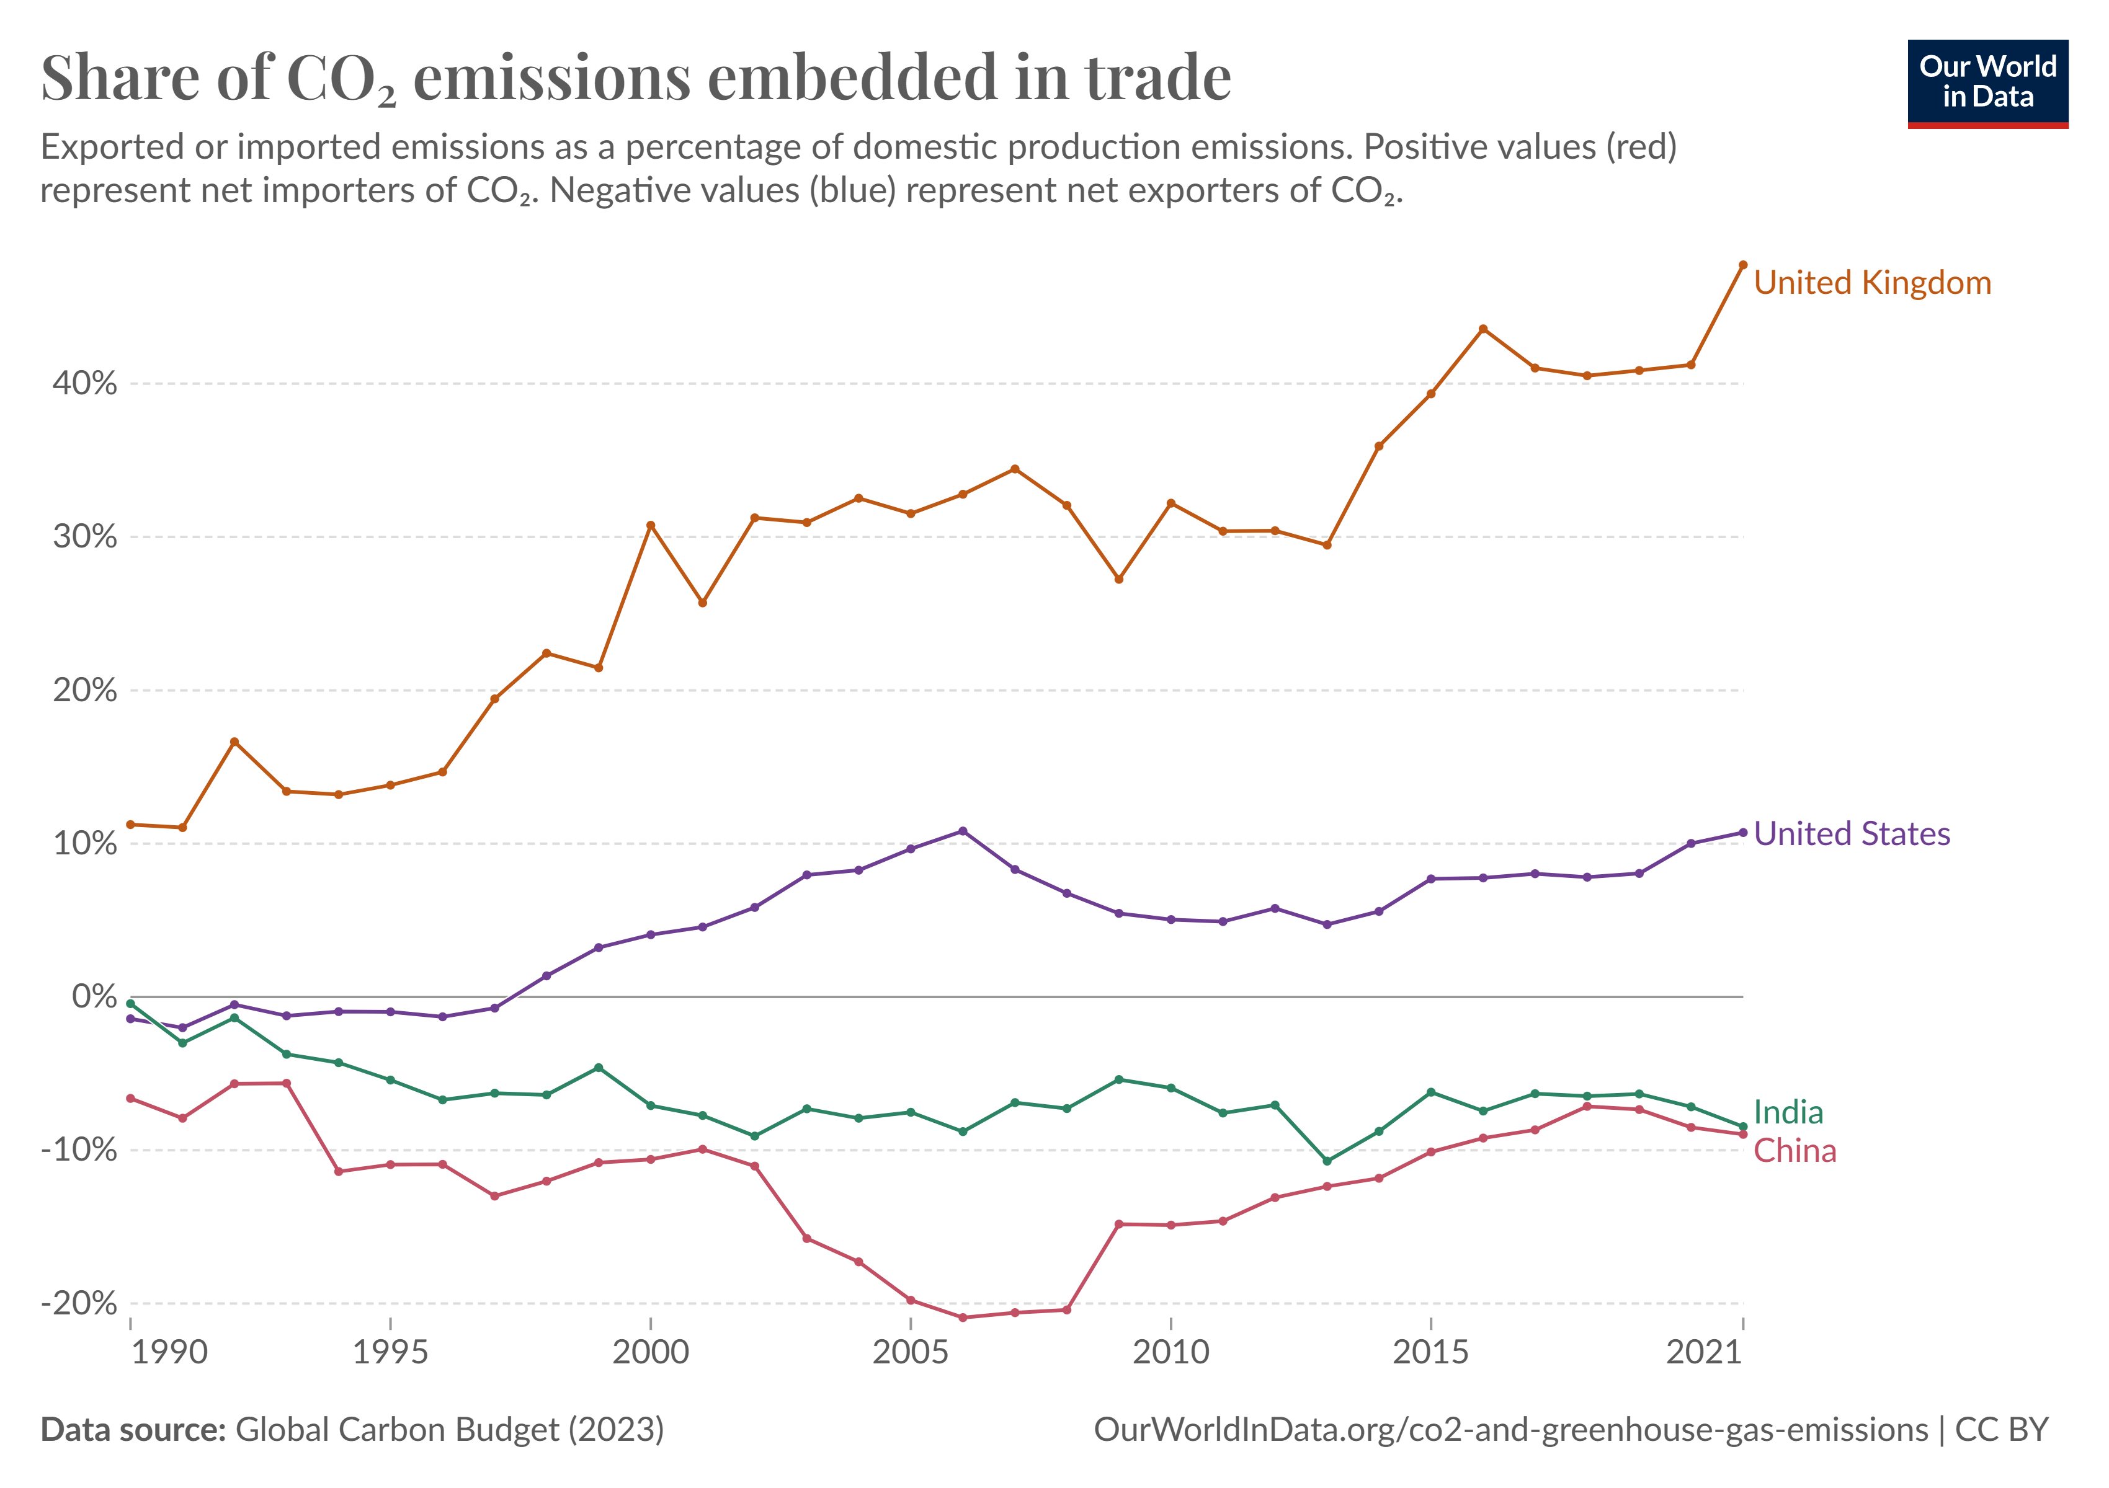
GOOGLE IT INFRASTRUCTURE

Slide 30
GOOGLE ENERGY EFFICIENT COMPUTING
Efficient Data Centers:
For over a decade, Google has meticulously designed and operated data centers to maximize efficiency.
Their mantra: "More out of every watt."
On average, a Google data center is twice as energy-efficient as a typical enterprise data center. The power usage effectiveness (PUE) metric reflects this efficiency, with Google consistently achieving impressive results¹.
ISO 50001 certification verifies their continuous efforts to improve energy efficiency across data centers. [17]
Sustainable Hardware Lifecycle:
Google is committed to achieving Zero Waste to Landfill for its data center operations. Circular economy principles guide their server management:
Reuse: Materials are repurposed multiple times.
Refurbish and Remanufacture: Hardware gets a second life. Reduce Waste: Minimize waste generation.
Recycle and Resell: Responsible disposal options.
In 2018, Google diverted 87 percent of waste from landfills in its global data centers.

Slide 31
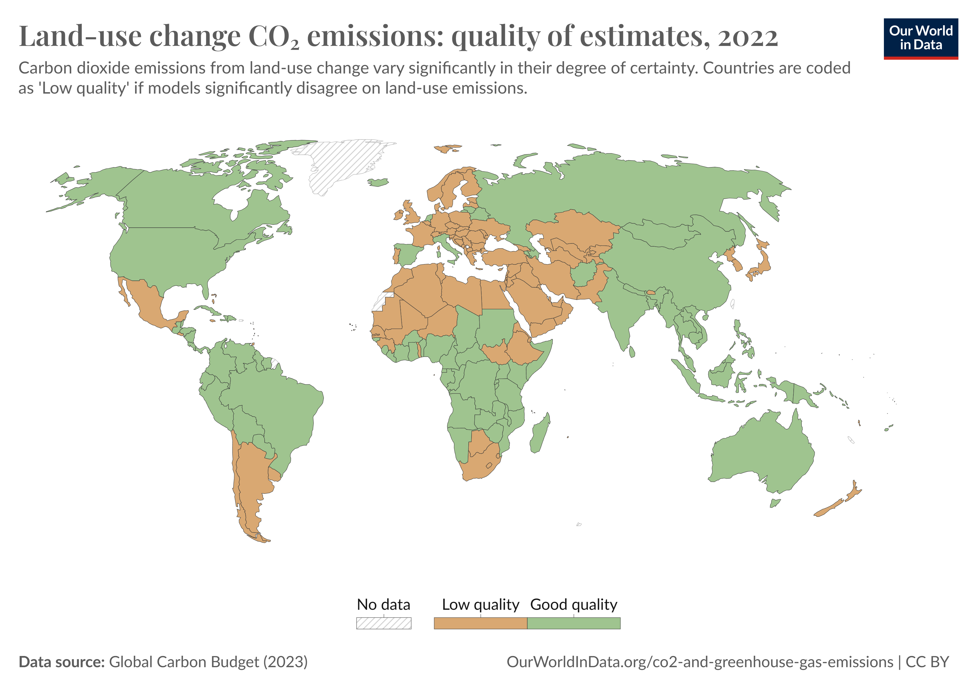
GOOGLE IT INFRASTRUCTURE

Slide 32
GOOGLE ENERGY EFFICIENT COMPUTING
Cloud Computing and Energy Savings:
Google’s cloud services, including Google Apps, contribute to energy savings.
Migrating basic IT applications to the cloud significantly reduces energy consumption and car- bon emissions.
The cloud’s scalability and resource optimization benefit both users and the environment.
By embracing cloud-based solutions, companies can lower costs, reduce their carbon footprint, and enhance productivity [18]
A Greener Future:
Google’s data centers, powered by renewable energy, exemplify their commitment to a cleaner, healthier planet.
Their virtuosic feats of virtualization and energy management set a high bar for the industry. As technology evolves, Google continues to innovate, ensuring that energy-efficient computing remains at the heart of their mission¹.

Slide 33
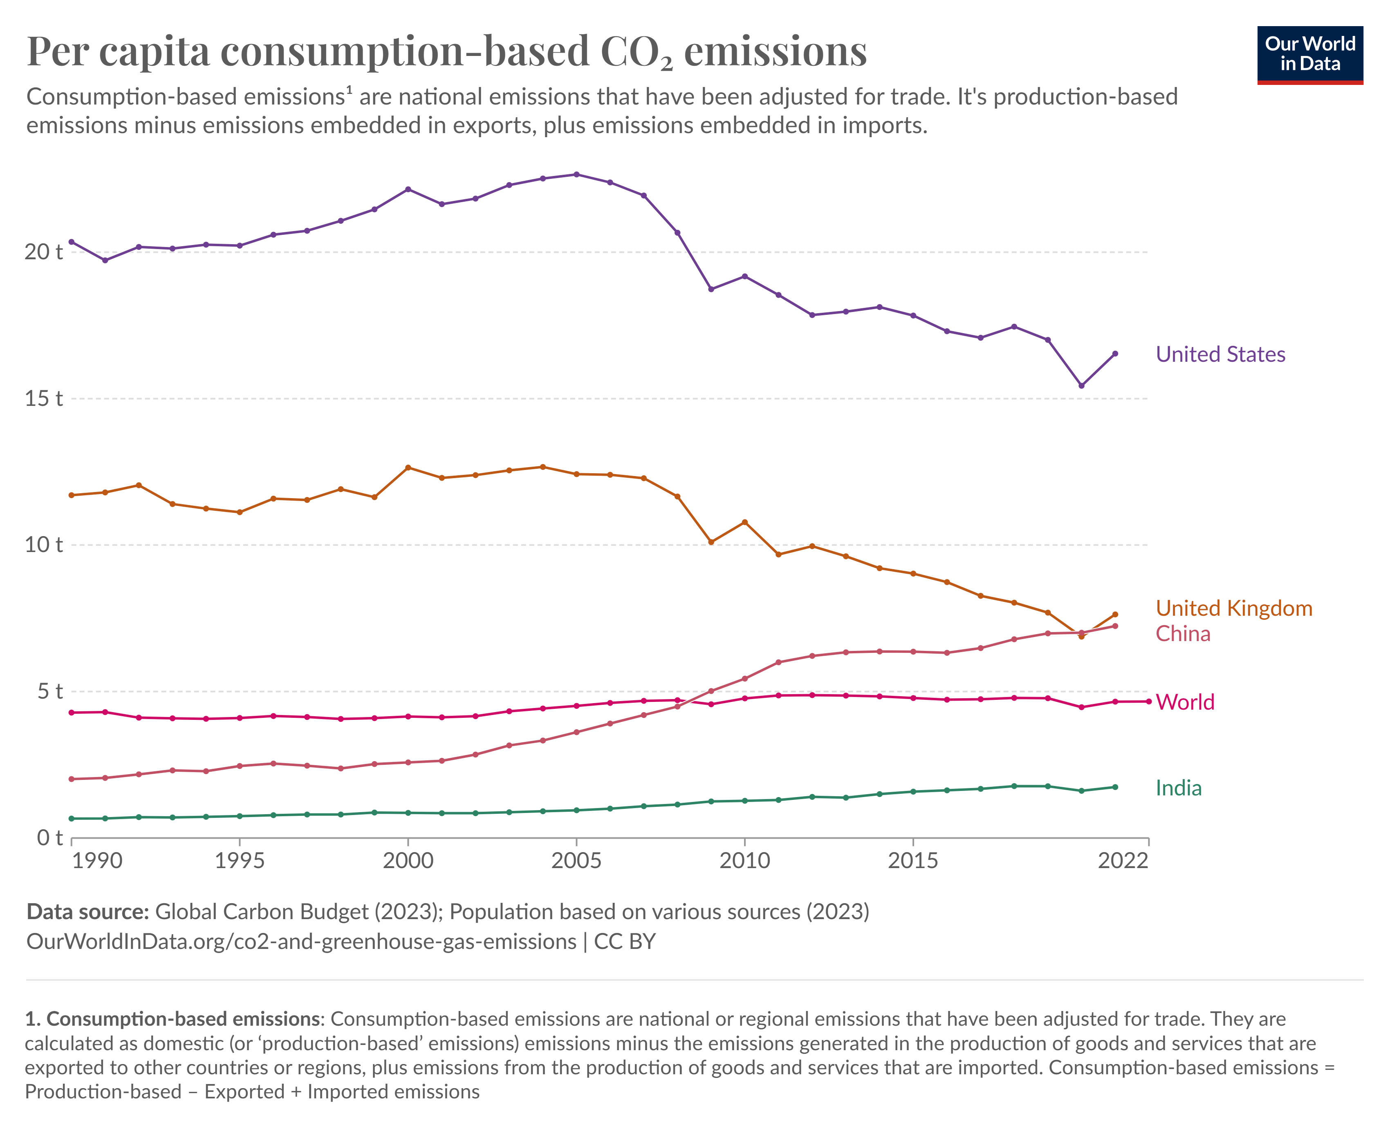
GOOGLE IT INFRASTRUCTURE

Slide 34
GOOGLE ANALYTICS & SUSTAINABILITY
Data-Driven Solutions: Google leverages its products and platforms to help people make sustainable choices. Whether it’s optimizing travel routes in Google Maps for fuel efficiency or suggesting energy-saving appliances through Google Shopping, they encourage environmentally conscious decisions. Their Environmental Insights Explorer assists cities and local governments in analyzing emissions data, tree coverage, and renewable solar energy to identify climate action strategies
Collaboration and Emissions Reduction: Google collaborates with partners to reduce emis- sions and advance transformative technology. Their ambitious goal is to achieve net-zero emis- sions across their operations and value chain by 2030. They’re also committed to powering data centers and office campuses with 24/7 carbon-free energy, such as solar and wind
AI and Breakthroughs: Google’s deep legacy in research and breakthroughs in artificial intelligence (AI) drive innovation. They’re using AI to tackle climate change, explore earth science data through Google Earth Engine, and build a resilient future for cities. Their aim is to help individuals, cities, and partners collectively reduce 1 gigaton of their carbon dioxide equivalent emissions annually by 2030.

Slide 35
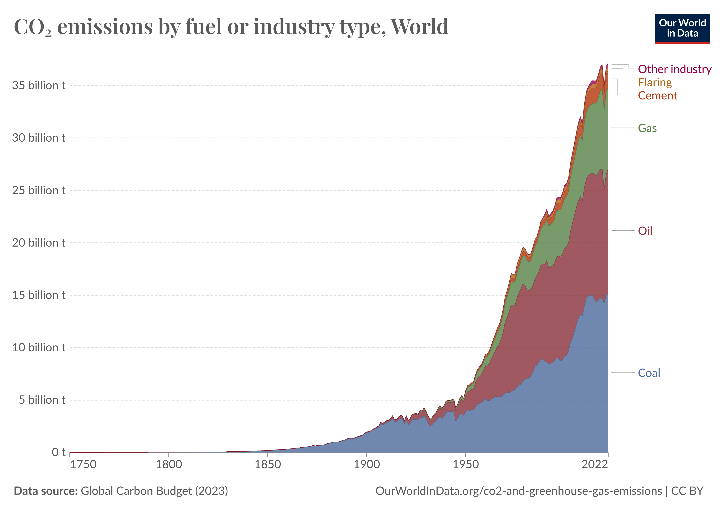
GOOGLE IT INFRASTRUCTURE

Slide 36
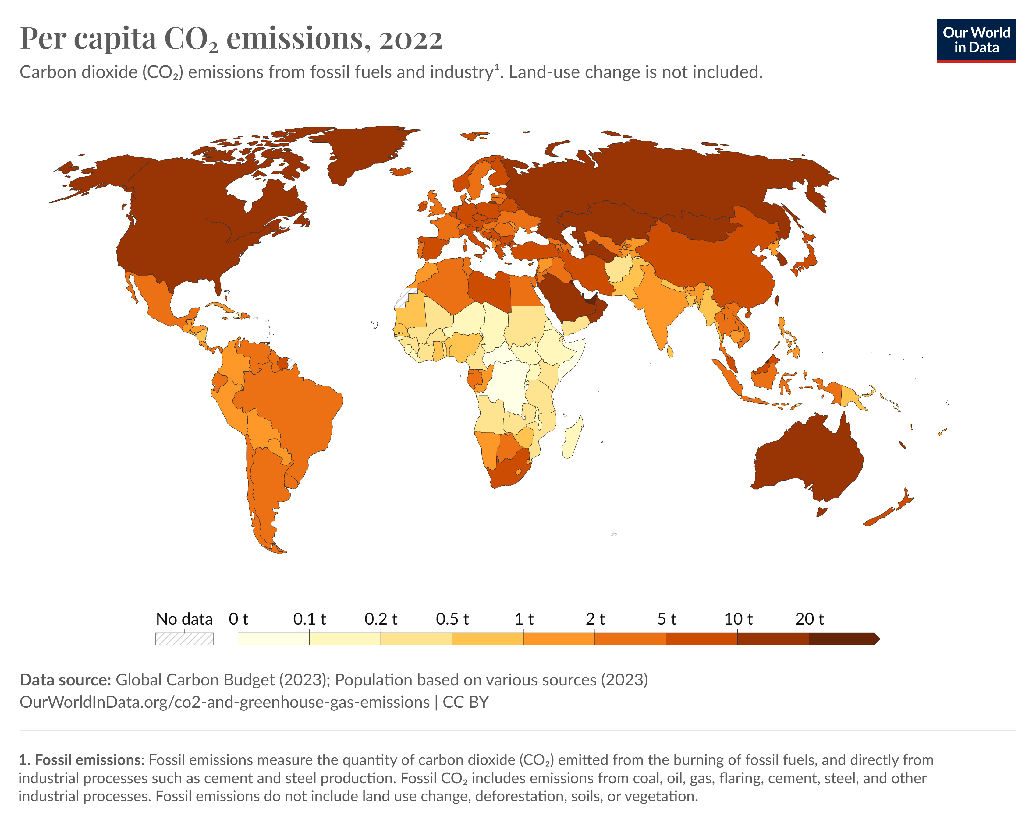
GOOGLE IT INFRASTRUCTURE

Slide 37
GOOGLE’s GREEN IT EXPECTED BENEFITS
Google’s adoption of green IT techniques promises a multitude of expected benefits for sus- tainability across its operations. By implementing energy-efficient technologies and sustainable practices, Google aims to minimize its environmental footprint while maximizing operational efficiency and resource utilization. One of the key anticipated benefits lies in reduced energy consumption and carbon emissions. Through initiatives such as server virtualization, data center optimization, and renewable energy sourcing, Google can significantly lower the energy requirements of its IT infrastructure, leading to reduced greenhouse gas emissions and environ- mental impact.
Furthermore, the integration of green IT techniques enables Google to achieve cost savings and operational efficiencies. By optimizing resource usage, minimizing hardware requirements, and leveraging cloud computing, Google can streamline its IT operations and reduce capital and operational expenses associated with data center management and maintenance. This not only enhances the company’s bottom line but also reinforces its commitment to sustainable business practices.

Slide 38
Python Code Additions

Slide 39
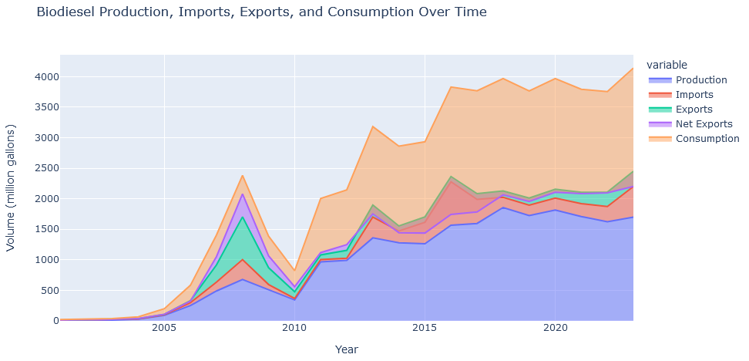
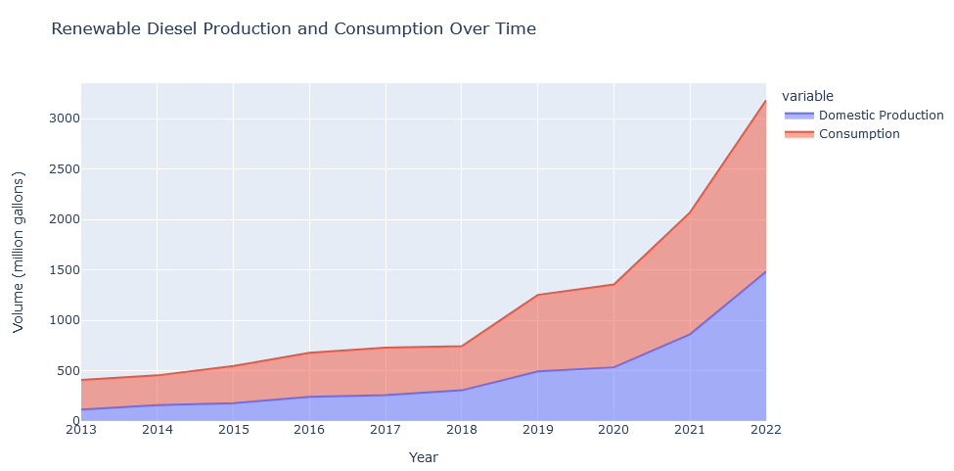
UNDERSTANDING THE PROBLEM
Carbon footprinting
In 2022, they introduced the Carbon Sense Suite, which includes products such as Carbon Footprint and Active Assist, and tools such as Cloud region picker. The suite is enabling Google Cloud customers to accurately measure, report, and reduce their cloud-related carbon emissions. They help developers and organizations make low-carbon architecture decisions and provide best practices to improve sustainability.
Renewable energy
Wind farms are an important source of carbon-free electricity, but wind can fluctuate depending on the weather. Through Google Cloud, customers like Engie (a global energy and renewables supplier) can optimize their wind portfolio in short-term power markets by predicting wind power output 36 hours ahead of actual generation and making optimal hourly delivery commitments to the grid, a full day in advance.

Slide 40
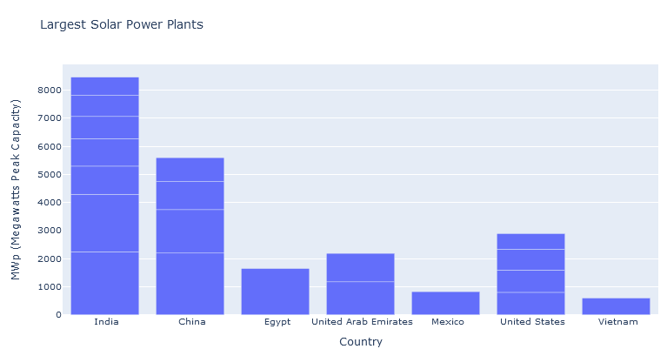
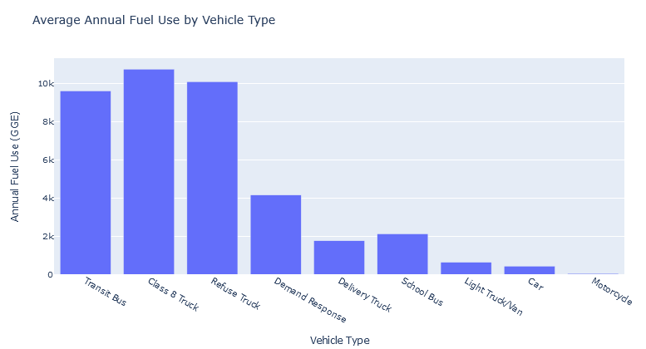
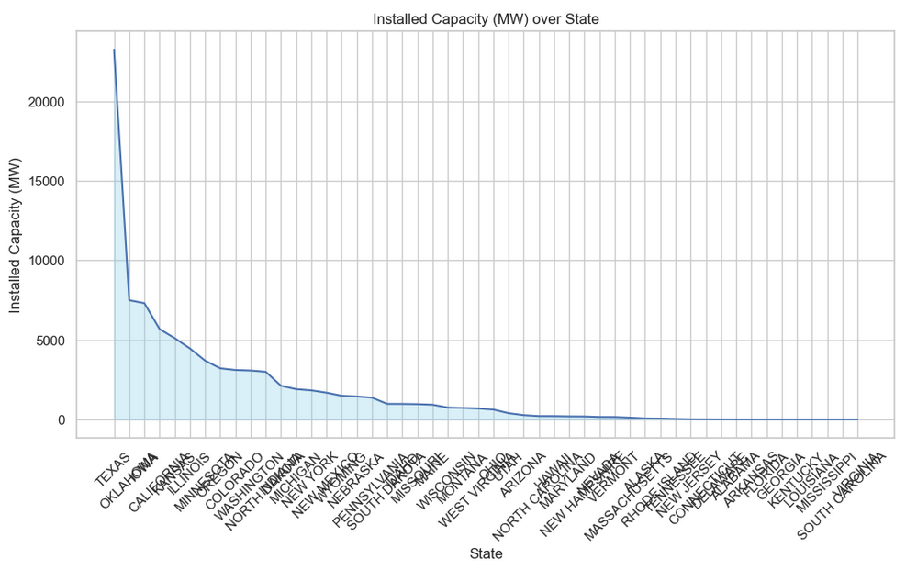
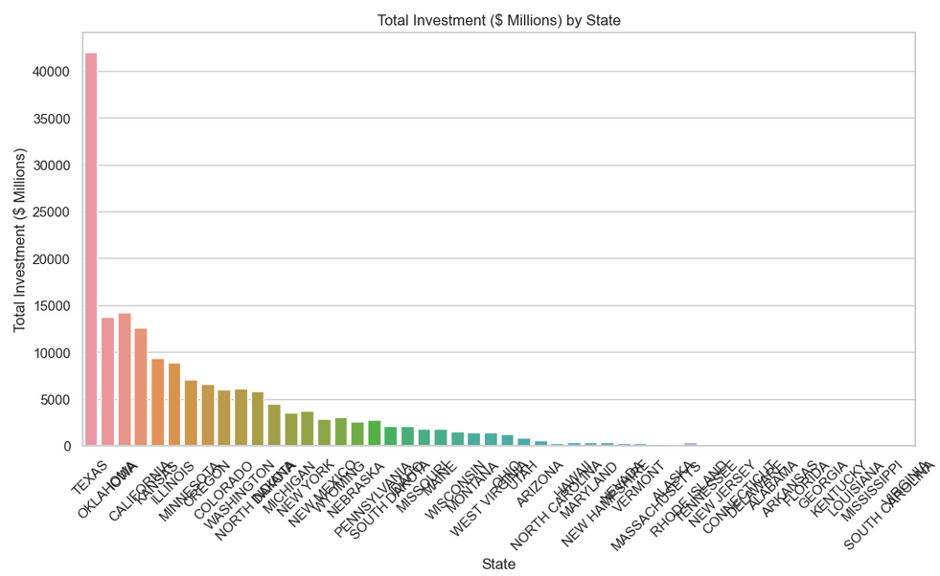
US STATE STATS TO SHOW PROBLEMS

Slide 41
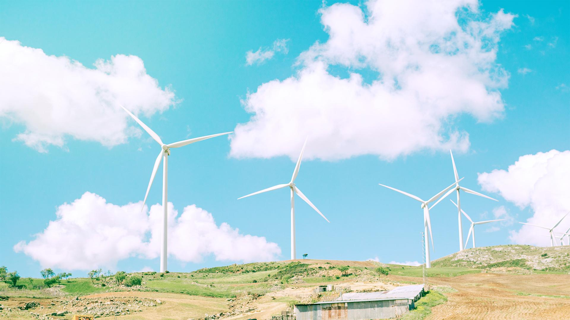
US STATE WIND ENERGY

Slide 42
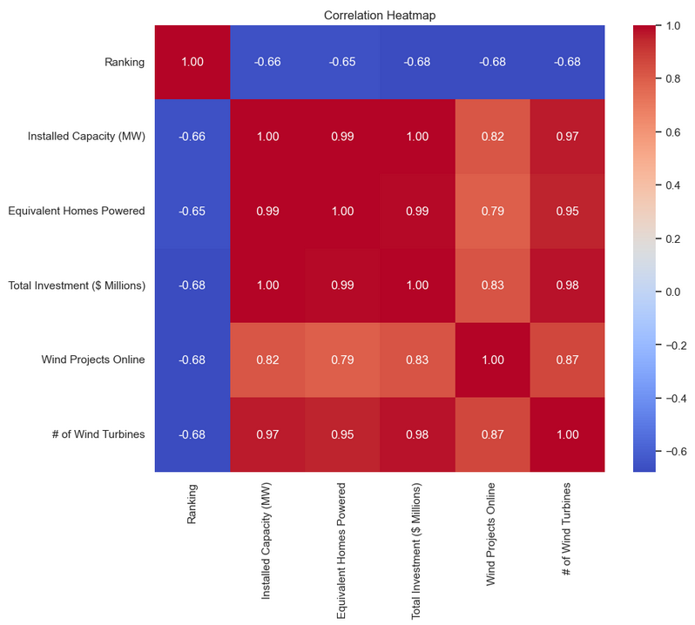
US STATE WIND ENERGY STATS

Slide 43
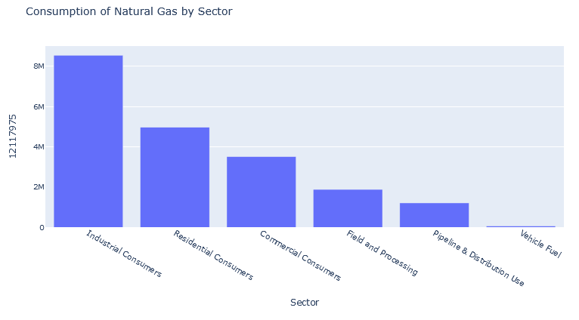
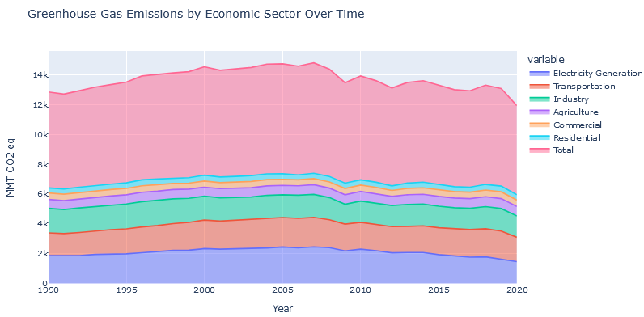
US Greenhouse Gas Emissions
US Consumption
of Natural Gas

Slide 44
CONCLSION
In conclusion, Google’s commitment to sustainability through its Green IT techniques exem- plifies responsible corporate citizenship. Here are some key takeaways:
Leadership and Accountability: Google’s proactive stance in adopting sustainable practices sets a precedent for other tech companies. By holding itself accountable to ambitious goals, it inspires collective action across the industry.
Holistic Approach: Sustainability isn’t an isolated endeavor; it’s woven into Google’s DNA. From data centers to product design, every aspect is scrutinized for environmental impact. This holistic approach ensures lasting change.
Collaboration: Google collaborates with governments, NGOs, and other stakeholders to drive systemic change. By sharing knowledge, resources, and best practices, it fosters a global community committed to sustainability.
Innovation: Google’s investment in AI and cutting-edge technologies fuels innovation. Whether optimizing energy usage or predicting climate patterns, these advancements contribute signifi- cantly to a greener future.
Empowering Users: Through user-friendly tools and platforms, Google empowers individuals and businesses to make sustainable choices. From carbon footprint calculators to renewable energy options, it democratizes access to eco-conscious solutions.

Slide 45

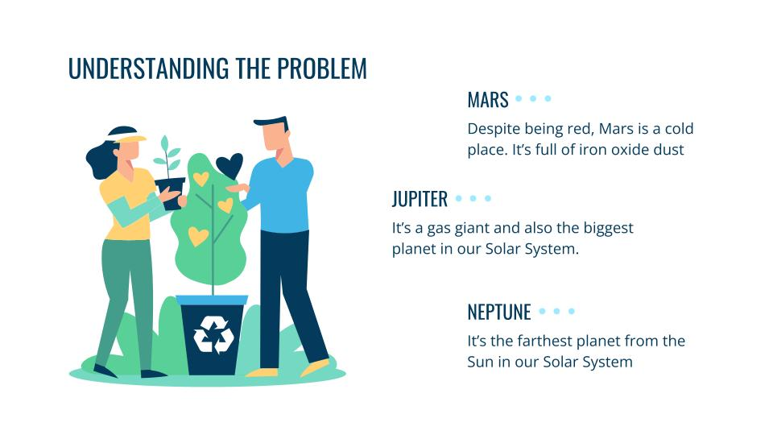

Presented by Chhavi Verma 8th sem ISE Dept.
]]

Slide 46
THANK YOU

